Slide 1

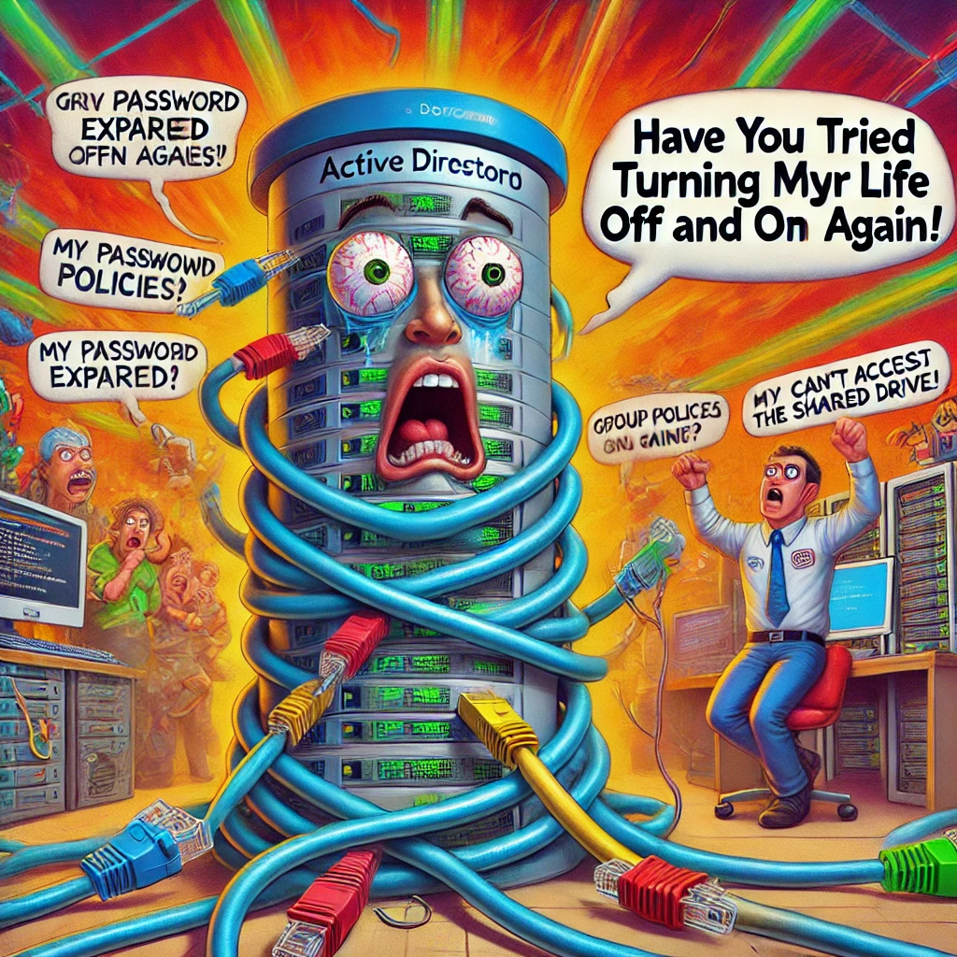

A̴̼̘͕̯̼̮̲͋̀̊̽̉ͅc̷̫̰̈̉t̵̹̞̗̦̹̱̖̜̻̿̒̆̀̀̿͂͝į̶̘̹͇̗̱͕̭̤̙͑̒̈́v̸̨̞̪͚̗͖̄̆ͅë̸̙̀͆̌̋́͋̒ ̷̡̟̞̥̦̜͉́̍̀̓Ḑ̵̫͖̥̅̓̀i̴͖̽̑͌̅͗ŗ̸͍̩̗̰̞̩̖̠̑e̸̳̩̭̙͎̞̗̺̚c̵̦̬͐́͠ṭ̶̡̣̪̙͕̞̞͌́̓̌̆̉͊o̴̹̗͚͖̺̓̓͂͆͊̽̉͋̅ͅr̷̡̼͕̻͚̈́͒̄̊͝͝y̶̬͚̬̼̟̩͈̩̓̾

Slide 2


Slide 3

Active directory is the directory structure designed by Microsoft
different to Linux
way that it stores data
how the user would traverse it in CLI
…This means new commands and new tools

Slide 4


Some :
Linux | Windows
cd mkdir cp mv exit nano cat ping chmod ifconfig man [command name] | cd mkdir copy move exit edit type ping attrib ip config [Command name]/?

Slide 5
Some MORE :
Linux | Windows
./[program] passwd whoami | Start [program] net user whoami

Slide 6

Now Tools B)

Slide 7
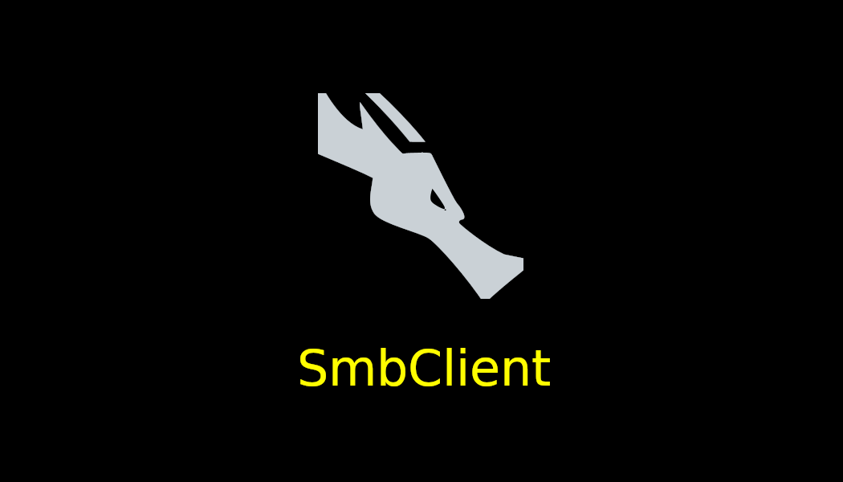


Server Message Block Client:
Remote desktop tool
Used for managing SMB servers
Exploring file structure
Download
Delete
Upload
Create

Slide 8


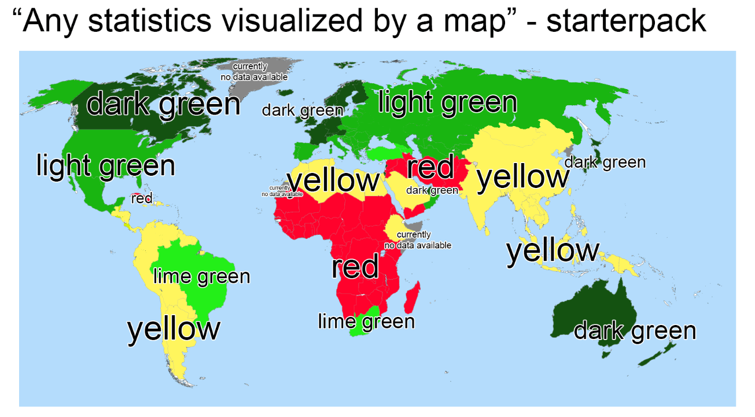
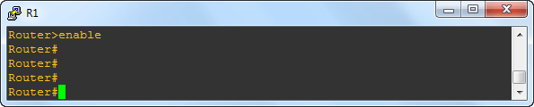

Slide 9


Slide 10


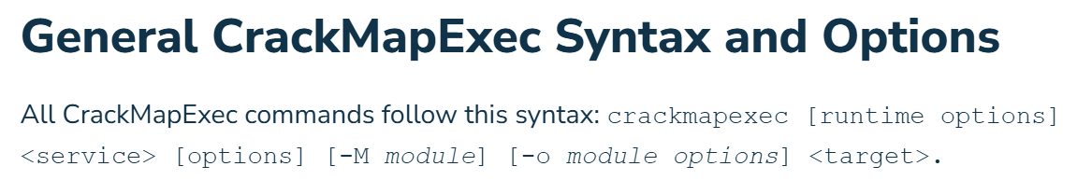
Crackmapexec is a ‘swiss-army knife’ type hacking tool
AD enumeration
Domains, users and groups
Cred brute forcing
Password spraying over a number of networks like SMP, RPC, LDAP and WinRM
Remote Code Execution
Lateral Movement

Slide 11



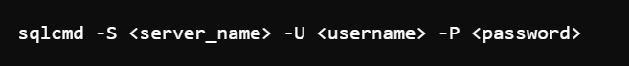
Microsoft SQL:
Just SMB client but for SQL servers
It sucks
Hate using sql
Combines the two worst things in ethical hacking
I don’t want to write any more about it

Slide 12



WinPEAS is a windows network enumeration tool
Run it by curling it onto the target
Produces a colour-coded analysis of misconfigurations on a network
Exploit and Priv Esc on that thang
Outputs Can Include:
Unquoted service paths
Modify the path to execute a malicious binary
Plaintext credentials
Extract plaintext passwords
Weak folder permissions
Replace an exe with something more devious
WinPeas
WINPEES

Slide 13



Evil-WinRM is a Windows Remote Manager exploitation tool
Uses NTLM Creds to hijack an open WinRM port
Gives the user PowerShell shell access
Evil evil-winrm be like: I am a legitimate way of remotely accessing a windows client ☺

